Slide 1


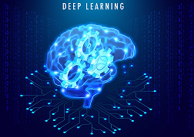
Welcome to Deep learning
Sugandh Gupta
Gril lab

Slide 2
Lecture Outcomes:
Understand the concept of Deep Learning
Understand the important terms and concepts involved in Deep Learning

Slide 3
contents
AI vs ML vs DL
Why Deep Learning?
What is Deep Learning?
Applications
What is Deep Neural Network?
YOLO vs. other detectors
Working of YOLO
YOLO Versions
Implementation with YOLO

Slide 4
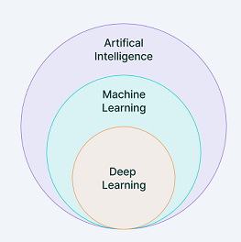

Slide 5
AI VS ML VS DL
1956 (Mcarthy) Machine to mimic Human Behaviour | 1959 (Samuel) Machine to ‘Learn’ Training Testing | 2000 (Aizenburg) Algo inspired by structure and function of Human Brain Training Testing
AI
ML
DL

Slide 6
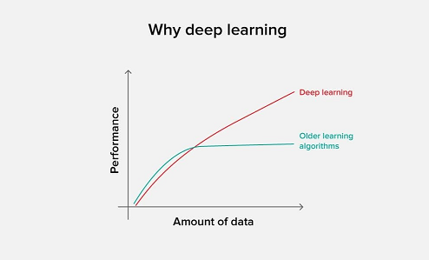

Slide 7
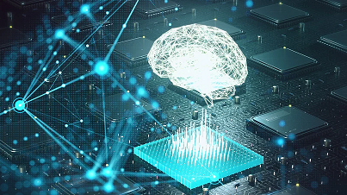
What is Deep Learning?
Mimics the network of neurons in brain
Type if machine learning based on artificial neural network
Multiple layers of processing used to extract progressively higher level features from data
Input Layer
Hidden Layer
Output Layer

Slide 8
Why Deep Learning?
Handles huge amount of data
Increased Computing Power
Complex Problems
Feature Extraction

Slide 9
Applications
Robotics
Medical Field
Self Driving Cars
Translation

Slide 10
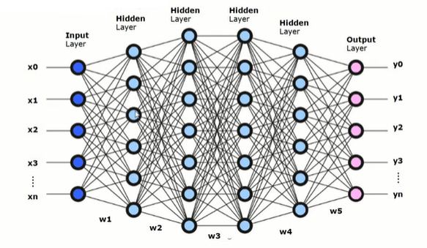
What is Deep Neural Network?
Artifcial Neuron/Perceptron
An Arificial Neural Network (ANN or NN) with multiple layers between Input and Output layers

Slide 11
Steps involved in object detection
Import the images
Annotation
Dataset Creation
Train the Model (YOLO)
Deploy the model for Object Detection

Slide 12
Important Metrics in Object Detection
Precision
Recall
Ratio of the number of true positives to the total number of positive predictions.
Ratio of the number of true positives to the total number of actual (relevant) objects.
For example, if the model detected 100 trees, and 90 were correct, the precision is 90 percent.
For example, if the model correctly detects 75 trees in an image, and there are actually 100 trees in the image, the recall is 75 percent.
Precision = (True Positive)
(True Positive + False Positive)
Recall = (True Positive)
(True Positive + False Negative)

Slide 13
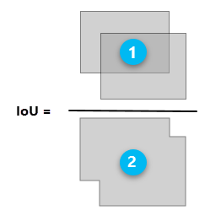
Important Metrics (contd…)
Intersection over Union(IoU) :
Precision-Recall Curve
Phenomenon in object detection that describes how boxes overlap.
Used as a threshold for determining whether a predicted outcome is a true positive or a false positive.
Plot of precision (y-axis) and recall (x-axis)
considered a good predictive model if the precision stays high as the recall increases

Slide 14
Important Metrics (contd…)
Average Precision
Mean Average Precision (mAP)
Area under the curve of the precision-recall curve
Generally used for Single Class
Average AP over multiple IoU thresholds.
Generally used for Multiple Class

Slide 15
Thank you…..

